Slide 1
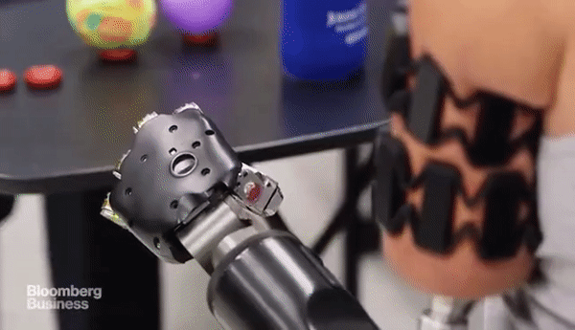
Do muscle synergies in the arm change when learning to use a multi-articulate pattern recognition controlled prosthetic hand?
Date: July 10, 2020
Source: bloomberg-https://gfycat.com/coarseultimateanemone
Presented by :
Alok Ranjan (s3816494)
Medical Device Design
Biomedical Engineering (M.Sc.)
Thesis Supervisor :
dr. R.M. (Raoul) Bongers
Center for Human Movement Sciences
University Medical Center Groningen
University Supervisor: prof. dr. ir. G.J. (Bart) Verkerke Rehabilitation-General Department University Medical Center Groningen
Notes:
Hi everyone, I welcome you all to the final presentation of my masters thesis.
Introduce
We worked on finding if muscle synergies change when***
This picture: Johnny Matheny, osiointegration, transhumeral amputation, Targeted muscle reinnervation : DARPA-funded prosthetic prototype 120 mil usd:Johns Hopkins Applied Physics Laboratory (Courtney Moran)
transradial
next

Slide 2
Outline
Introduction
Material and Methods
Results
Discussion
Conclusion
Future work
Notes:
Introduce ,factors, that define our objective and RQ
M&M: participants, the myoelectric system, the procedure, dataset and data analysis
Results
Discuss : what are the usage of this technology, what problems I faced, what can make things better
Conclusion
Future work: things that can be done and will give much better understanding

Slide 3
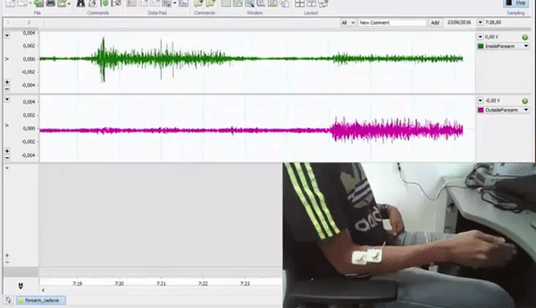
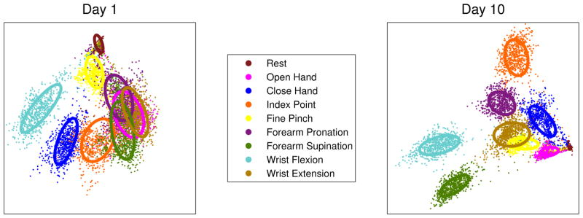

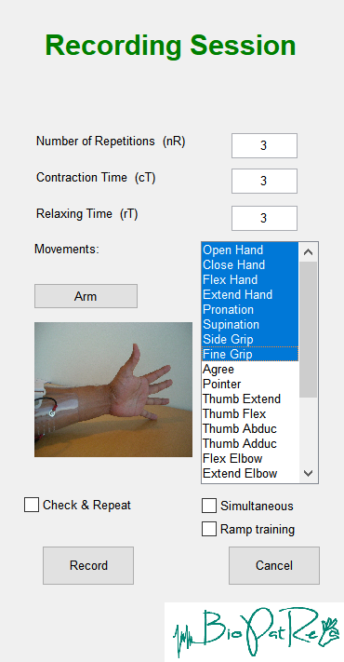
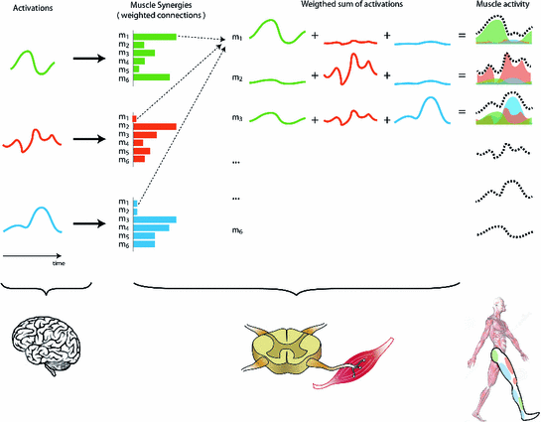
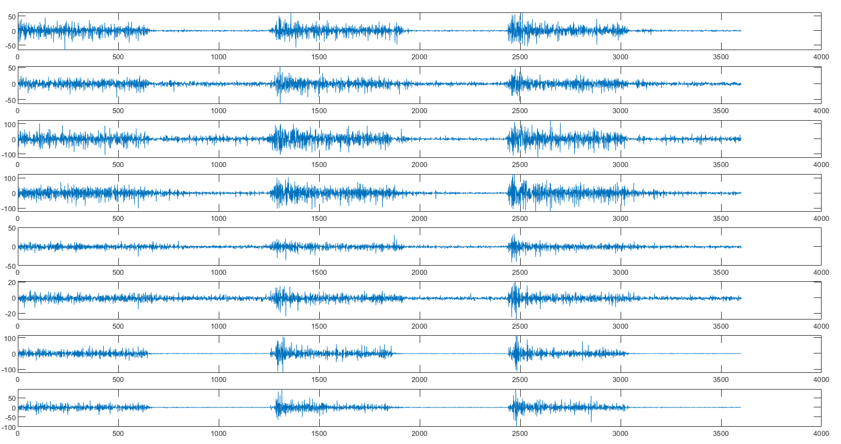
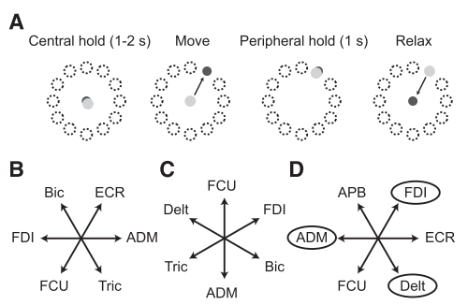
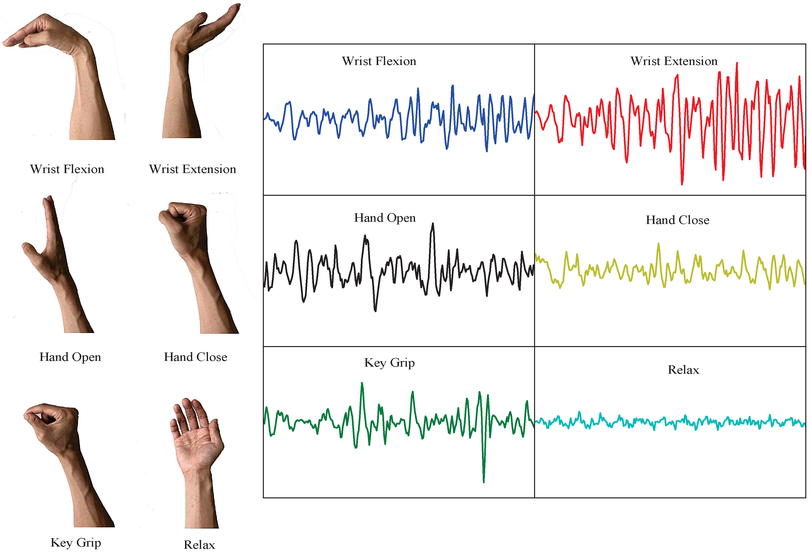
Introduction
Pattern recognition
User learning
Feedback: visual or sensory
Muscle synergies
A training exercise
Objective
Research questions
Figure 6: A representation of consistent and separable features [6]
Figure 1: Representation of EMG signal acquiring process [1]
How do control commands change over learning to use a pattern recognition (PR) controlled prosthesis.
Figure 2: A recording session in BioPaTrec [2]
Figure 3: Example of acquired EMG data via. BioPatRec and Thalamic MyoArmband [3]
Do muscle synergies change over learning to use PR controlled prosthesis?
Do muscle activation coefficient patterns change over learning to use PR controlled prosthesis?
Figure 7: A representation of how muscle synergy and activation commands generate and work [7]
Figure 4: Representation of different hand movements and their respective EMG shapes [4]
Figure 5: Intuitive and non-intuitive assignments of muscles [5]
Notes:
Before explaining objective, I will explain the three major pillars of this analysis
1. PR: wide term, statistical data analysis -> features (magnitude, mean absolute value, variance, root mean square), decode information ,relation bw input information and an output behavior, ex: Tesla cars recognising other cars, sign boards
In Prosthesis , EMG, mapping, trying to this action and relate the patterns to do a task, Information need not to strictly relevant, Radhakrishnan ‘s cursor experiment (intitutive, non-intitutive), direction of action (DOA)
Successful PR: consistent and reproducible across trails, inter class separable, variability, fine pinch example
Training: explain figure, Optimize training, modular, Learning what will change the activation of control commands to desired activations. We can answer this question only if we first will look for how the control commands change over learning. And what are the underlaying factors about it.
MS: Russian physiologist and movement scientist Nikolai Bernstein: a hierarchical model to explain the construct of movements: flexible hierarchical control: redundant degrees-of-freedom
He suggested that the nervous system decreased the complexity inherent in coordinated postures and movements by reducing the number of degrees of freedom by imposing suitable constraints.
It has been suggested that such constraints may manifest themselves in two different ways, namely at a kinematic level or in terms of muscle synergies. For example, kinematic constraints such as a fixed set of relationships among the angular motions of different limb segments (link in speech), kinematic constraints could conceivably arise from muscle synergies.
muscle synergies are proportional activations of a group of muscles. NMF

Slide 4
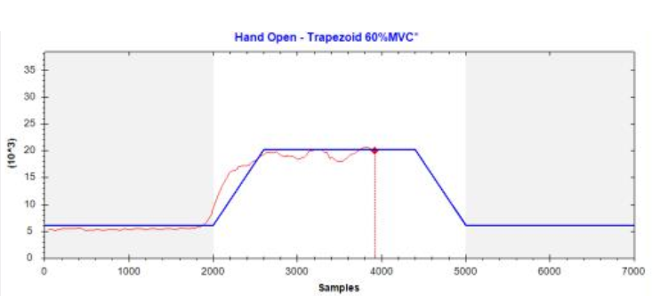

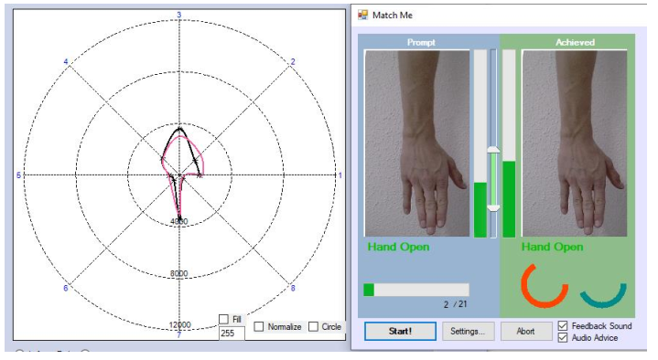
Materials and Methods
Participants (ECB/2017.01.12_1)
20, mean age of the group = 22 ± 2.8 years, 11 females
Myoelectric machine learning system
Eight double differential electrodes, 1000 Hz Otto Bock Healthcare Products GmbH, Vienna, Austria
Pre-amplified and band-pass filtered the EMG signals
Procedure
A 5- day training exercise
Day 1: pre-test (10 min), training session (20 min)
Day 2-4: training sessions (30 min)
Day 5: training session (20 min) , post-test (10 min)
Rest, wrist supination, wrist pronation, wrist flexion, wrist extension, hand open, fine pinch grip, and lateral thumb grip
30% MVC, 60%MVC, 90%MVC
Linear Discriminant analysis (LDA) based classifier
The Dataset : 20 P * 15 tr
Figure 8: Recording of training data with MVC maintained (Top), Match prompt test. Left panel: The eight axes correspond to the eight electrodes’ root mean square (center = zero , outer boundary = 100% MVC). The black line continuously displayed the current EMG activation pattern, whereas the colored line displayed the mean EMG pattern of the movement which was Classified (Bottom) [8]
Notes:
User training+feedback

Slide 5
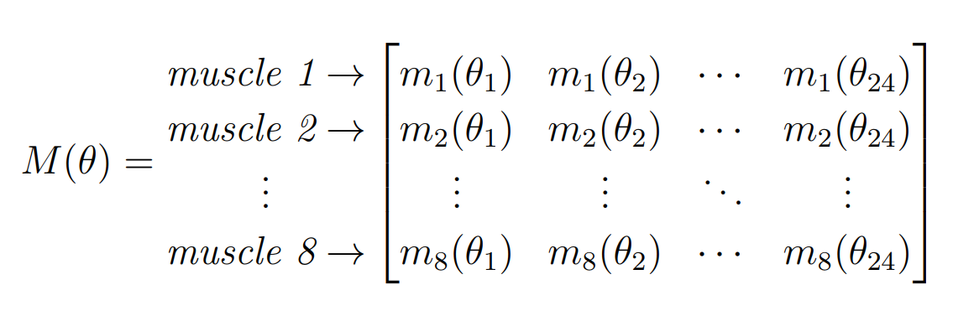
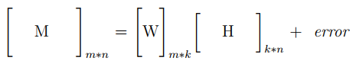
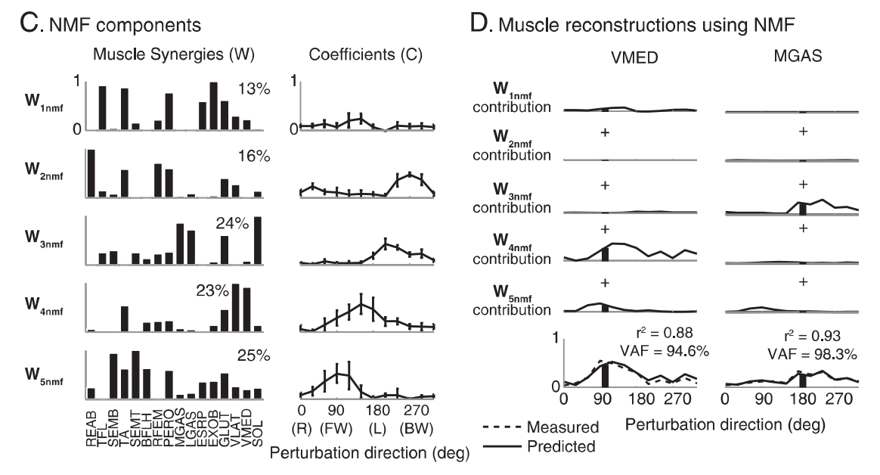
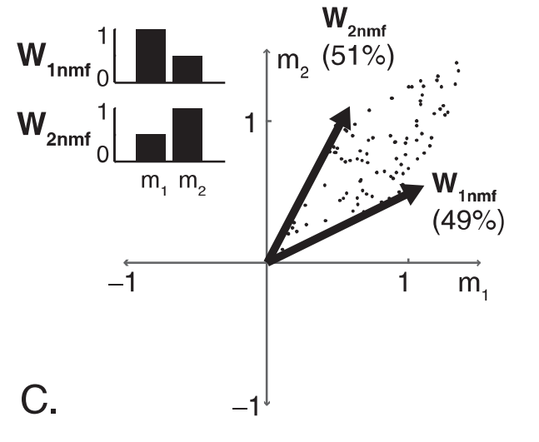
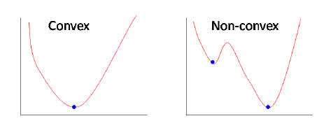
Materials and Methods
Data analysis
Pre-processing: absolute, normalize muscle-wise
Muscle Synergies’ model and NMF
A convex optimization problem
Dimensionality analysis
To reduce dimensions
Procedure
VAF=1-SSE/SST
Figure 9: Convex and non-convex optimization problems [9]
Figure 10: A representation of non-negative matrix factorization, how components are located in data [10]
Figure 11: components and activation coefficients identified from postural response data using NMF [10]
Notes:
SSE = sum of squared errors of the reconstructed data by multiplying W and H matrices
SST = sum of squared residuals
VMED=vastus medialis, inward side above knee

Slide 6
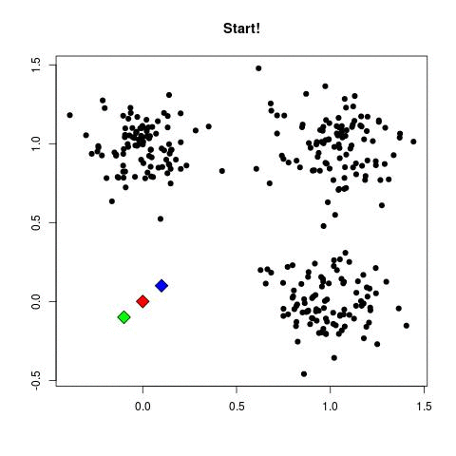
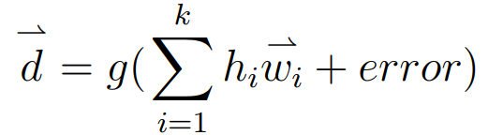
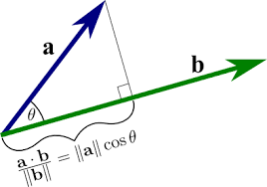
Materials and Methods
Simulated data vs Observed data
8-channel and 22-channel
Simple vs Forced solutions
M_{j} and M_{r}=W*H
nnmf: algorithm: als, MaxIter:100, TolX:10⁻⁴, TolFun:10⁻⁴
NMF_als: with larger number of iterations, break if MAPE <10⁻⁵
Similarity analysis
Normalized dot product (NDP)
Cosine of principal angles (CPA),
k-means clustering
Figure 12: A representation of how k-means clustering changes its centroids and therefore, clusters change over iterations [11]
Figure 13: A representation projection of two vectors [12]
Notes:
TolFun — Termination tolerance on change in size of the residual.
TolX — Termination tolerance on relative change in the elements of W and H.
MAPE = mean absolute percentage error
NDP=1=same, cos(th)=1, th=0.
CPA: angle theta=0
K-means

Slide 7
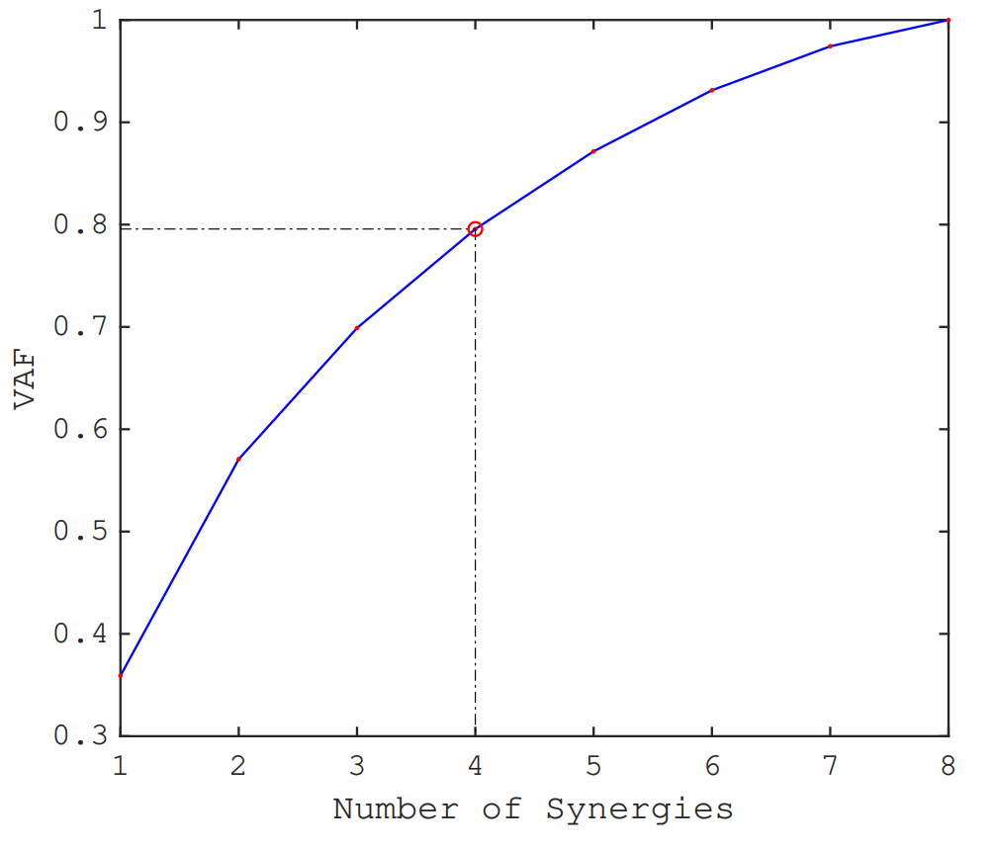

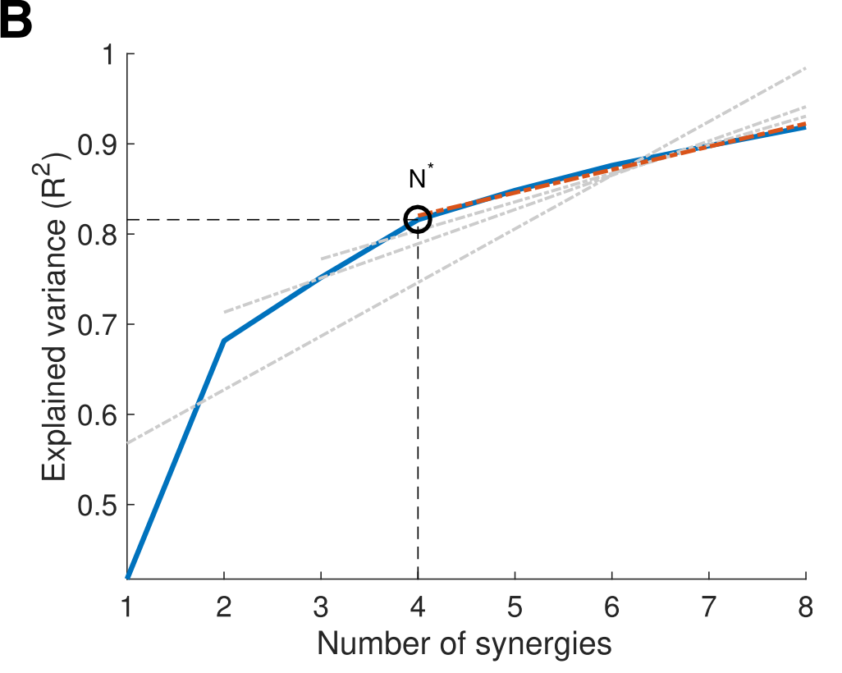
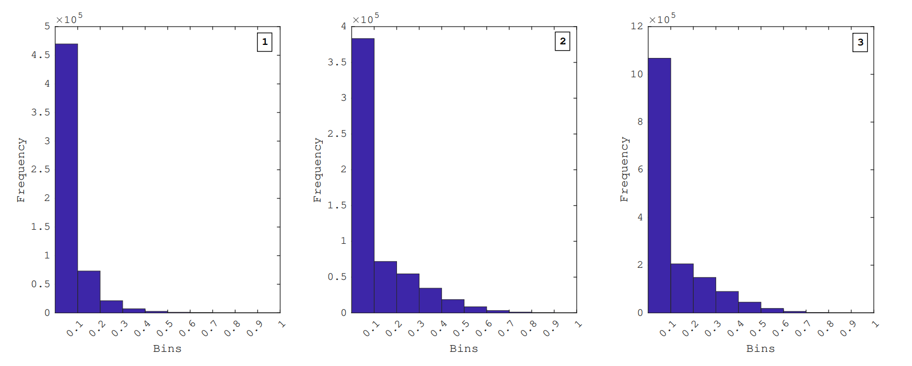
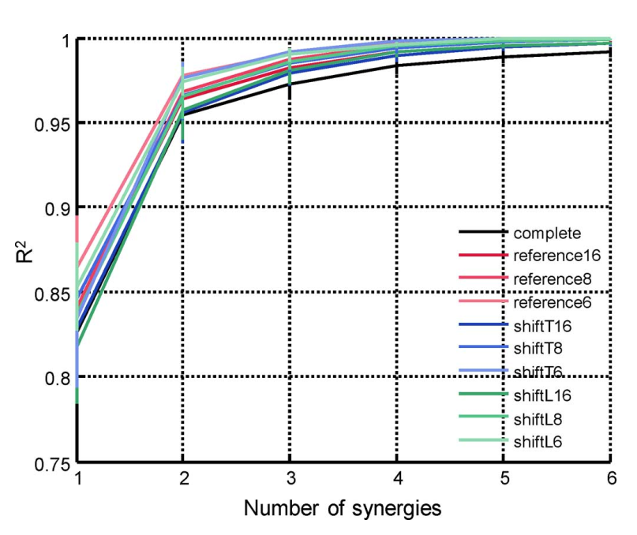
Results
Table: number of synergeies ,VAF and its cumulative difference
Number of Synergies | VAF (%) | Cumulative Difference (%)
1 | 35.91
2 | 57.08 | 21.16
3 | 69.89 | 12.81
4 | 79.57 | 9.67
5 | 87.16 | 7.59
6 | 93.13 | 5.96
7 | 97.43 | 4.29
8 | 100 | 2.57
Dimensionality analysis
Lower dimensionalize :
if cumulative difference is low
VAF diff: 21, 13, 10, 8, 6, 4, 3
80% cut-off
Simulated data vs Observed data
Simple vs Forced solutions via NMF
W10, W25, W50, Wb50
Figure 14: VAF vs number of synergies for our data
Figure 15: VAF vs number of synergies in Valk 2019 [14]
Figure 16: Histograms of (1) an 8-channel observed data, (2) an 8-channel simulated data, and (3) a 22-channel simulated data
Figure 16: VAF vs number of synergies in Muceli 2014 [15]

Slide 8
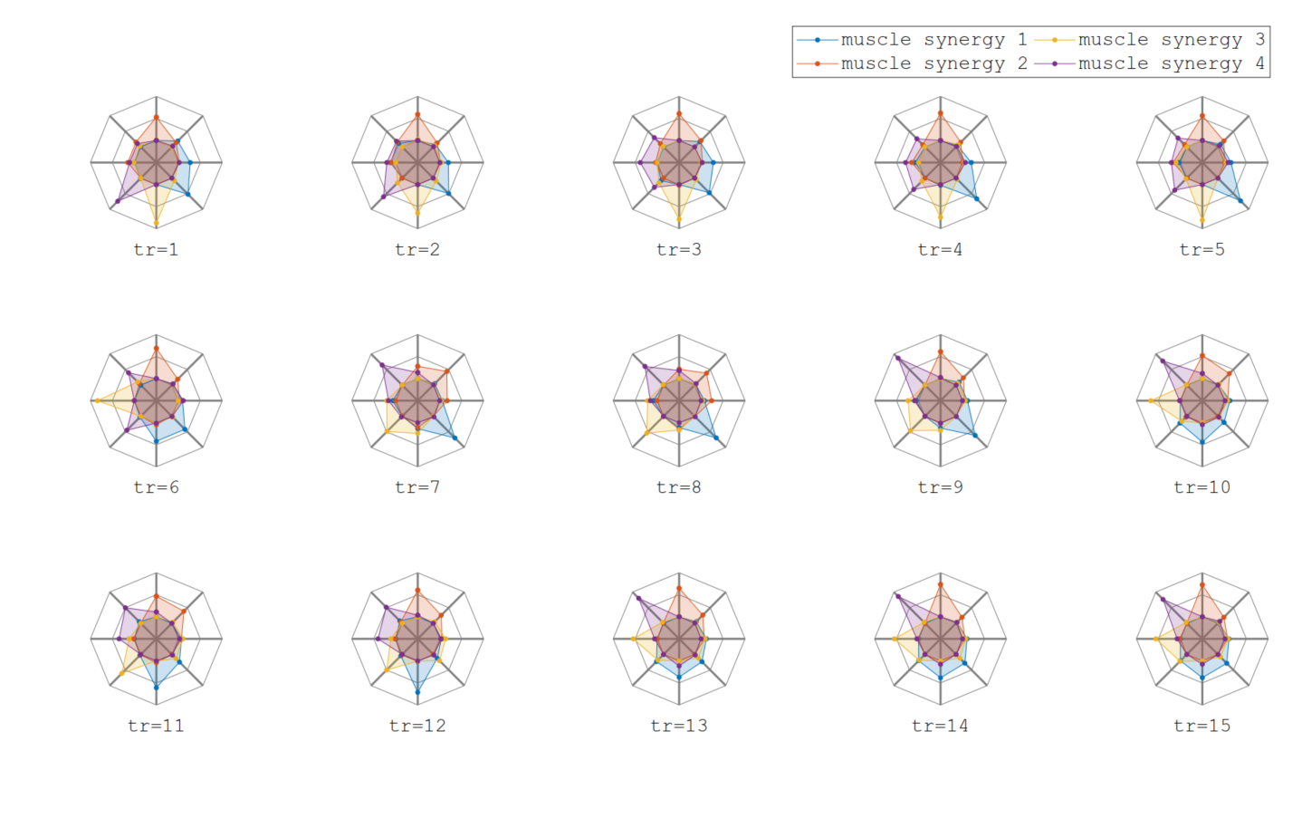
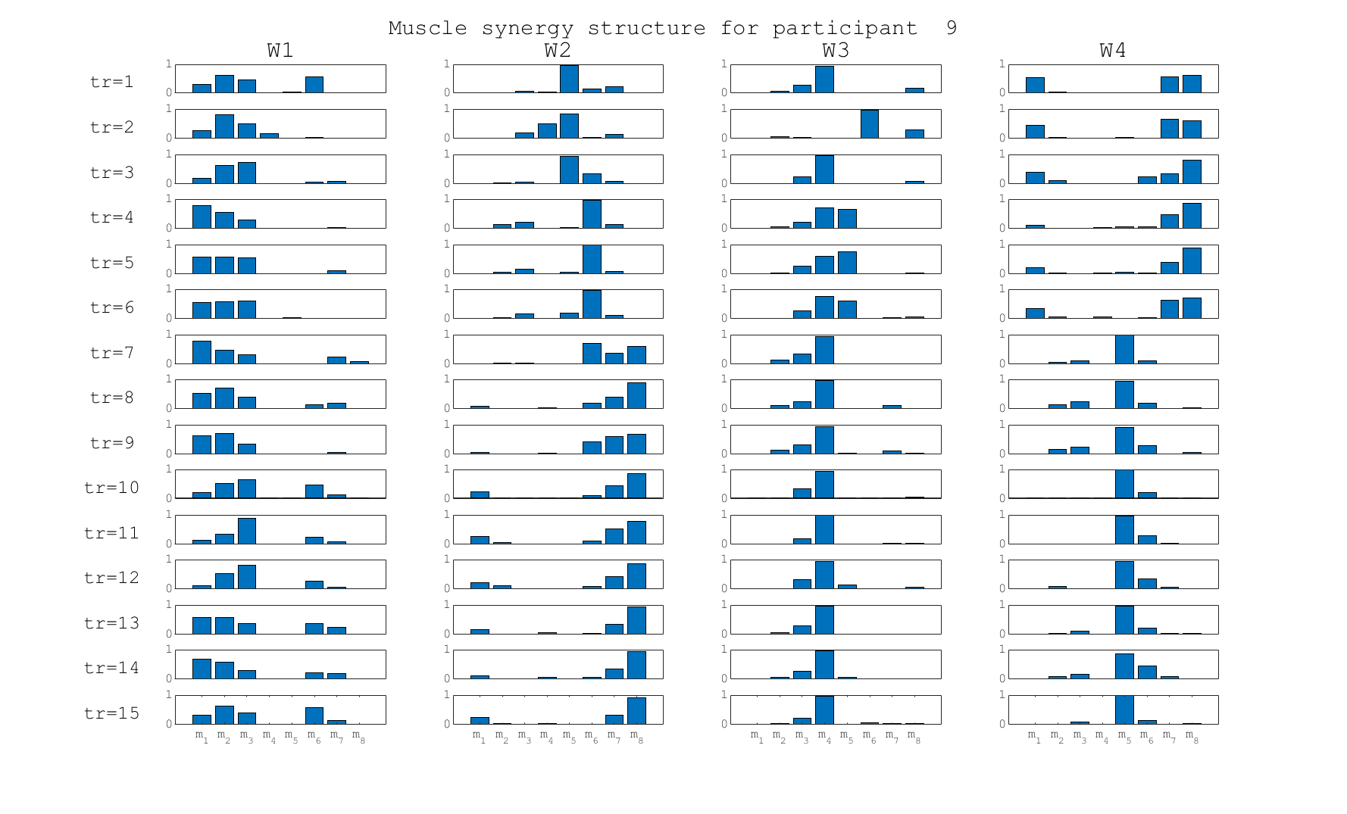
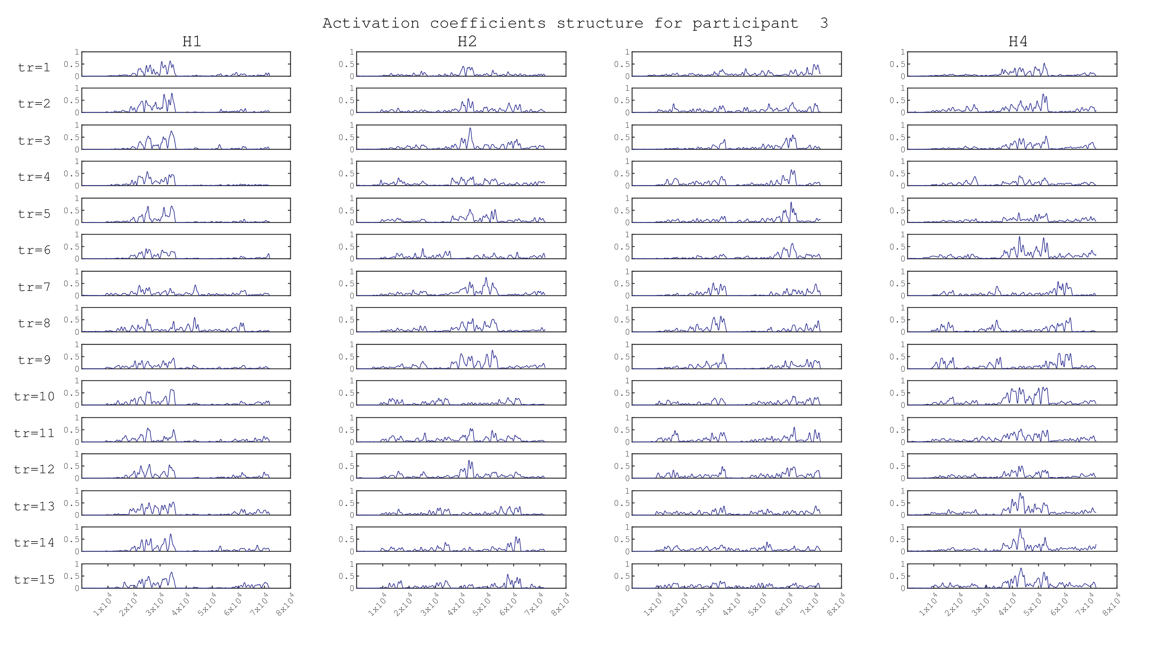
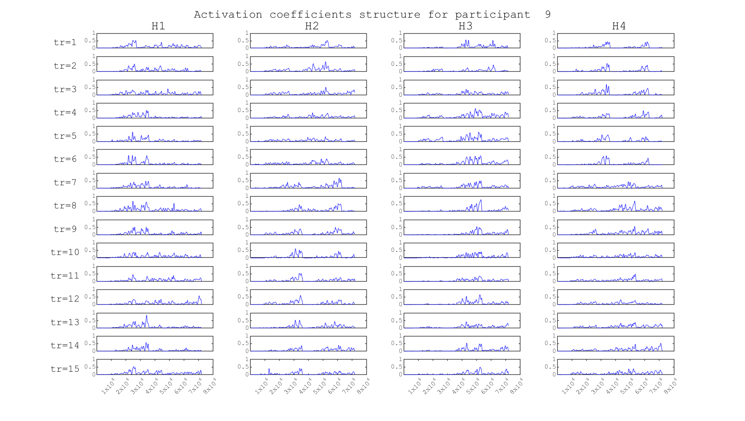
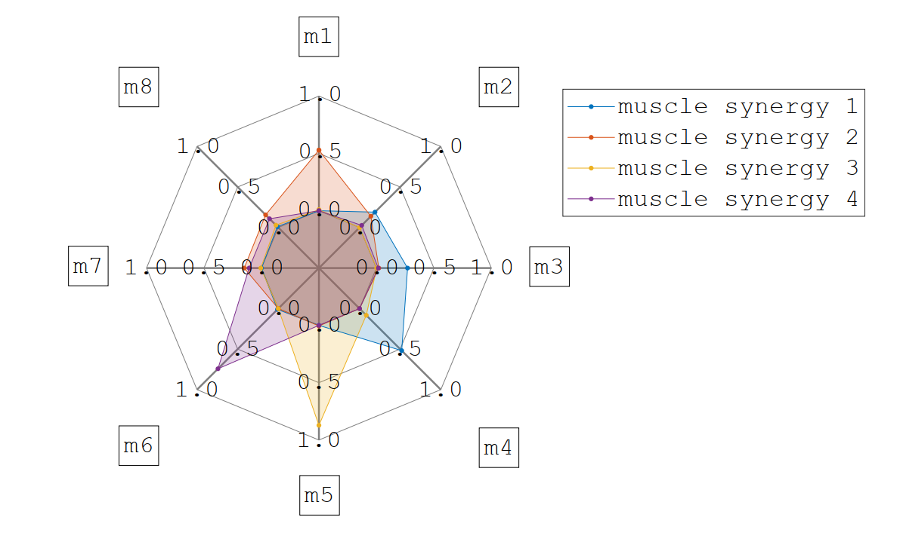
Results
Table 1: From initial to final averaged solution, angular change (CPA) in synergy structure for each participant
(P#) | W1 | W2 | W3 | W4
1 | 0.16 | 0.09 | 0.59 | 0.38
2 | 0.75 | 0.97 | 1.47 | 1.43
3 | 1.43 | 0.69 | 1.47 | 0.22
4 | 1.36 | 1.48 | 0.81 | 1.50
5 | 1.28 | 1.38 | 1.43 | 1.28
6 | 1.47 | 1.51 | 0.97 | 1.25
7 | 1.45 | 1.49 | 0.09 | 1.36
8 | 1.39 | 1.43 | 1.41 | 1.20
9 | 0.21 | 0.12 | 0.14 | 0.25
10 | 0.53 | 1.48 | 1.48 | 0.18
11 | 0.81 | 1.25 | 1.01 | 0.14
12 | 1.48 | 0.18 | 1.39 | 1.38
13 | 0.25 | 0.71 | 0.42 | 0.56
14 | 0.28 | 0.34 | 0.24 | 0.34
15 | 0.14 | 0.10 | 0.68 | 0.95
16 | 0.94 | 0.13 | 0.58 | 1.43
17 | 1.39 | 1.34 | 0.32 | 1.34
18 | 1.15 | 1.45 | 1.51 | 0.07
19 | 1.35 | 1.28 | 0.93 | 0.50
20 | 1.45 | 0.08 | 1.33 | 1.48
Similarity analysis
NDP and CPA
k-means Clustering
P3 and P19
Averaged solutions with k-means clustering
CPA
Not correct for ( P6, P7, P8, P17, P18, P19)
Figure 20: Spider plots: Changing Synergy structure for P3
Figure 17: Bar Graph: Synergy structure for P9
Figure 19: A representation of activations in muscle synergies as a spider plot
Figure 18: Activation coeff structure over training sessions for P9
Figure 21: Activation coeff structure over training sessions for P3

Slide 9
(P#) | Initial averaged act. coefficient pattern (mean±SD) |  |  |  | Final averaged act. coefficient pattern(mean±SD)
- | H1 | H2 | H3 | H4 | H1 | H2 | H3 | H4
1 | 0.064±0.056 | 0.064±0.067 | 0.079±0.055 | 0.066±0.073 | 0.058±0.061 | 0.054±0.074 | 0.079±0.057 | 0.063±0.071
2 | 0.072±0.100 | 0.088±0.089 | 0.065±0.059 | 0.080±0.084 | 0.072±0.070 | 0.069±0.069 | 0.063±0.10 | 0.065±0.062
3 | 0.079±0.100 | 0.087±0.072 | 0.083±0.078 | 0.105±0.092 | 0.087±0.097 | 0.085±0.091 | 0.080±0.14 | 0.084±0.09
4 | 0.083±0.067 | 0.065±0.076 | 0.084±0.051 | 0.068±0.052 | 0.085±0.065 | 0.071±0.087 | 0.090±0.065 | 0.066±0.063
5 | 0.010±0.082 | 0.093±0.074 | 0.090±0.062 | 0.112±0.074 | 0.104±0.081 | 0.098±0.091 | 0.090±0.076 | 0.099±0.086
6 | 0.074±0.072 | 0.060±0.066 | 0.076±0.060 | 0.068±0.065 | 0.079±0.072 | 0.078±0.072 | 0.054±0.059 | 0.066±0.067
7 | 0.075±0.052 | 0.076±0.061 | 0.084±0.068 | 0.056±0.066 | 0.067±0.060 | 0.097±0.086 | 0.073±0.068 | 0.067±0.059
8 | 0.095±0.076 | 0.094±0.062 | 0.110±0.072 | 0.083±0.057 | 0.081±0.077 | 0.095±0.072 | 0.084±0.076 | 0.083±0.064
9 | 0.093±0.082 | 0.085±0.088 | 0.079±0.090 | 0.091±0.071 | 0.089±0.089 | 0.092±0.091 | 0.089±0.082 | 0.072±0.099
10 | 0.080±0.085 | 0.086±0.065 | 0.078±0.078 | 0.077±0.071 | 0.078±0.074 | 0.059±0.068 | 0.097±0.088 | 0.063±0.065
11 | 0.080±0.067 | 0.065±0.069 | 0.101±0.084 | 0.096±0.127 | 0.066±0.059 | 0.099±0.096 | 0.096±0.132 | 0.076±0.067
12 | 0.081±0.042 | 0.092±0.055 | 0.083±0.064 | 0.104±0.078 | 0.085±0.051 | 0.094±0.056 | 0.089±0.070 | 0.096±0.066
13 | 0.077±0.078 | 0.080±0.078 | 0.079±0.070 | 0.079±0.076 | 0.067±0.076 | 0.067±0.078 | 0.059±0.051 | 0.067±0.075
14 | 0.081±0.056 | 0.097±0.085 | 0.083±0.087 | 0.091±0.068 | 0.084±0.068 | 0.097±0.085 | 0.067±0.067 | 0.089±0.084
15 | 0.064±0.078 | 0.080±0.071 | 0.072±0.096 | 0.085±0.087 | 0.076±0.076 | 0.085±0.102 | 0.085±0.099 | 0.073±0.121
16 | 0.100±0.083 | 0.110±0.100 | 0.098±0.121 | 0.083±0.078 | 0.125±0.105 | 0.105±0.107 | 0.136±0.156 | 0.132±0.112
17 | 0.075±0.073 | 0.095±0.049 | 0.077±0.056 | 0.085±0.064 | 0.070±0.066 | 0.081±0.057 | 0.093±0.077 | 0.062±0.066
18 | 0.071±0.063 | 0.058±0.084 | 0.072±0.058 | 0.067±0.059 | 0.074±0.074 | 0.085±0.078 | 0.080±0.077 | 0.062±0.108
19 | 0.070±0.070 | 0.089±0.093 | 0.067±0.052 | 0.070±0.059 | 0.077±0.072 | 0.072±0.074 | 0.082±0.105 | 0.075±0.071
20 | 0.076±0.065 | 0.084±0.070 | 0.083±0.094 | 0.087±0.066 | 0.076±0.104 | 0.083±0.078 | 0.067±0.069 | 0.076±0.067
Table 2: Initial and final averaged solutions of activation coefficient patterns, represented in form of mean±SD for each participant

Slide 10

Discussions
A new mapping in brain
Feedback levels : visual, sensory
Modular learning : basic + personalized
Decrease in prosthesis rejection rate
Our data
VAF
Convex or non-convex?
Synergy mismatches and same day variations
Optimal clusters (5-7)
Is data good?
Re: Figure 17: Bar Graphs: Changing Synergy structure for P9 via. NDP or CPA

Slide 11

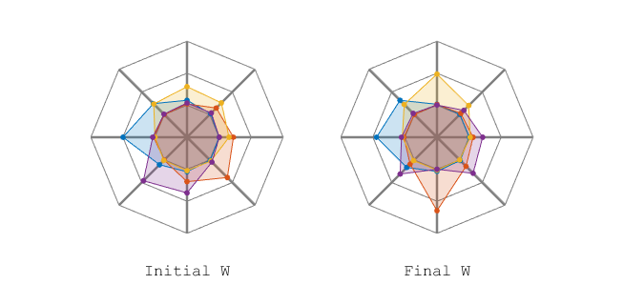
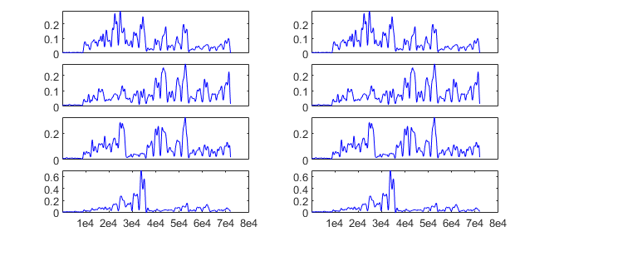
Conclusion
Muscle synergy structure changes
Activation Coefficients also change
Variation happens because of different activities and changing activations
Mean±SD
Figure 22: Averaged initial and final synergy and activation coefficients for P14

Slide 12

Future work
Redo the experiment
Track clustering with optimum number of clusters
 | tr=1 | tr=2 | tr=3 | tr=4 | tr=5 | tr=6 | tr=7 | tr=8 | tr=9 | tr=10
Cl7
Cl6 |  |  |  |  |  | o | o | o | o | o
Cl5 |  |  | o | o | o
Cl4
Cl3
Cl2
Cl1
Figure 23: A representation of how clustering solutions in more clusters can signify which synergies change

Slide 13
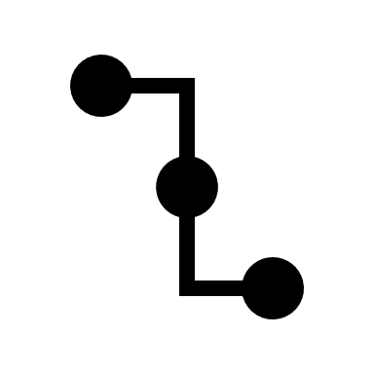
References
Image : adopted from : https://gfycat.com/wateryeducatedjoey (accessed on 09 July 2020)
Ortiz-Catalan M, Brånemark R, Håkansson B. BioPatRec: A modular research platform for the control of artificial limbs based on pattern recognition algorithms. Source Code Biol Med. 2013;8(1):11. Published 2013 Apr 18. doi:10.1186/1751-0473-8-11
Myoarmband: https://support.getmyo.com/hc/en-us/articles/203398347-Getting-started-with-your-Myo-armband (accessed on 09 July 2020)
Image: https://www.mdpi.com/1424-8220/19/20/4457/htm (accessed on 09 July 2020)
S. M. Radhakrishnan, S. N. Baker, and A. Jackson, \Learning a Novel MyoelectricControlled Interface Task", Journal of Neurophysiology, vol. 100, no. 4, pp. 2397{ 2408, Oct. 2008, issn: 0022-3077. doi: 10.1152/jn.90614.2008. [Online]. Available: https://www.physiology.org/doi/10.1152/jn.90614.2008.
M. A. Powell and N. V. Thakor, \A Training Strategy for Learning Pattern Recognition Control for Myoelectric Prostheses", Tech. Rep. 1, 2013, p. 30. [Online]. Available: http://www.oandp.org/jpo/library/printArticle. asp?printArticleId=2013%7B%5C_%7D01%7B%5C_%7D030.
Torricelli, D., Barroso, F., Coscia, M., Alessandro, C., Lunardini, F., Bravo Esteban, E., & d’Avella, A. (2016). Muscle synergies in clinical practice: Theoretical and practical implications. In Biosystems and Biorobotics (Vol. 10, pp. 251–272). Springer International Publishing. https://doi.org/10.1007/978-3-319-24901-8_10
A. W. Franzke, M. Kristoffersen, V. Jayaram, C. van der Sluis, A. Murgia, and R. Bongers, \Exploring the relationship between EMG feature space characteristics and control performance in machine learning myoelectric control", IEEE Transactions on Neural Systems and Rehabilitation Engineering, 2020.
He, J., Rexford, J., & Chiang, M. (2010). Design for Optimizability: Traffic Management of a Future Internet (pp. 3–18). https://doi.org/10.1007/978-1-84882-765-3_1
Lena H. Ting and Stacie A. Chvatal, Decomposing Muscle Activity in Motor Task: Motor Control: Theories, Experiments, and Applications. Oxford Scholarship, 2010, pp. 103{138, isbn: 9780195395273. [Online]. Available: https:// www.oxfordscholarship.com/view/10.1093/acprof:oso/9780195395273.001.0001/acprof-9780195395273-chapter-5.
Gif Image: https://in.pinterest.com/pin/68679963051465753/ (accessed on 09 July 2020)
Image: adopted from: https://mathinsight.org/dot_product
T. A. Valk, L. J. Mouton, E. Otten, and R. M. Bongers, \Fixed muscle synergies and their potential to improve the intuitive control of myoelectric assistive technology for upper extremities", Journal of NeuroEngineering and Rehabilitation, vol. 16, no. 1, Jan. 2019, issn: 17430003. doi: 10.1186/s12984-018- 0469-5.
S. Muceli, N. Jiang, and D. Farina, \Extracting signals robust to electrode number and shift for online simultaneous and proportional myoelectric control by factorization algorithms", IEEE Transactions on Neural Systems and Rehabilitation Engineering, vol. 22, no. 3, pp. 623{633, 2014, issn: 15344320. doi: 10.1109/TNSRE.2013.2282898.

Slide 14
Questions?

Slide 15
Thank You!

